Slide 1

Bootcamp
Dibimbing.id
Simple & Multiple Regression Models (Supervised)

Slide 2








PT Cakra Syntesis Indonesia
Android Developer (2016)
Nawatech
Jr. ML Engineer (2017)
Bukalapak
Data Scientist (2018 - 2020)
Data Scientist Instructor
(Sept 2020 - Nov2020)
Data Scientist Instructor
(2021 - 2021)
Evermos
Sr. Data Scientist - Data Lead
(2021 - present)
Data Scientist Instructor
(2021- present)
Trainer Bio
Arif Romadhan
Linkedin : https://www.linkedin.com/in/arif-romadhan19/

Slide 3

Outline
Recap: Machine learning
Introduction to Linear Regression
Linear Regression with Python
Single predictor
Multiple predictors
Model diagnostic
Model evaluation

Slide 4
Types of ML
RECAP
Based on target availability
01
02
1. Supervised learning
2. Unsupervised learning
Supervised = ground truth provided
I.e. target is available in training data
(x1,y1), (x2,y2), (x3,y3), etc..
Objective: to correctly predict y from unseen data x
Based on target variable type, can further be divided:
Regression
Classification
Unsupervised = no ground truth provided
I.e. target is NOT available in training data
(x1), (x2), (x3), …
Objective: to find hidden patterns in unlabeled data
Clustering
Dimensionality reduction

Slide 5
Types of ML
RECAP
Based on target availability
01
02
1. Supervised learning
2. Unsupervised learning
Supervised = ground truth provided
I.e. target is available in training data
(x1,y1), (x2,y2), (x3,y3), etc..
Objective: to correctly predict y from unseen data x
Based on target variable type, can further be divided:
Regression
Classification
Unsupervised = no ground truth provided
I.e. target is NOT available in training data
(x1), (x2), (x3), …
Objective: to find hidden patterns in unlabeled data
Clustering
Dimensionality reduction

Slide 6
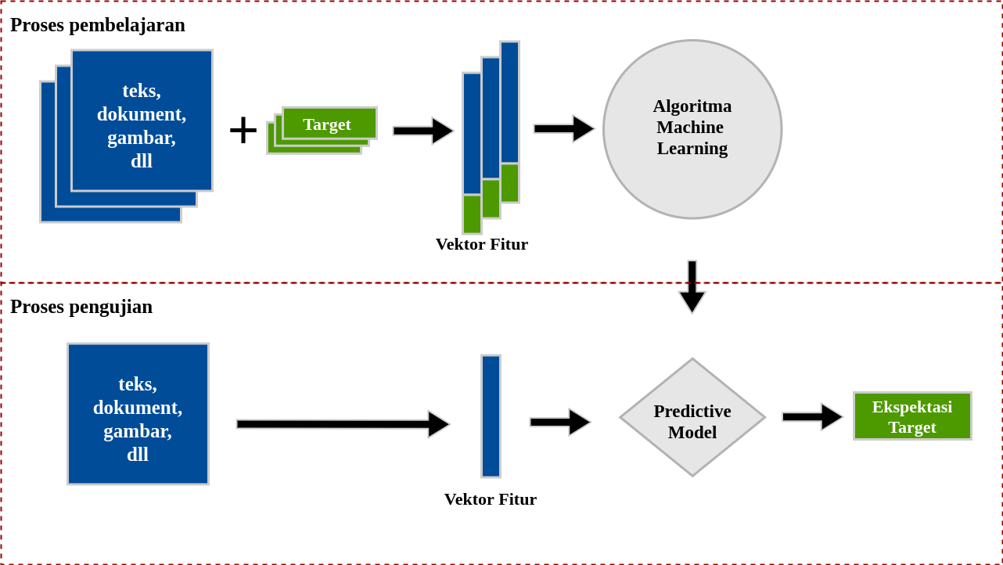

Workflow - intinya supervised itu “peramal” yang bisa memprediksi suatu kejadian di masa depan
Data Lama
Hasil Prediksi
Proses Prediksi
Data Baru

Slide 7
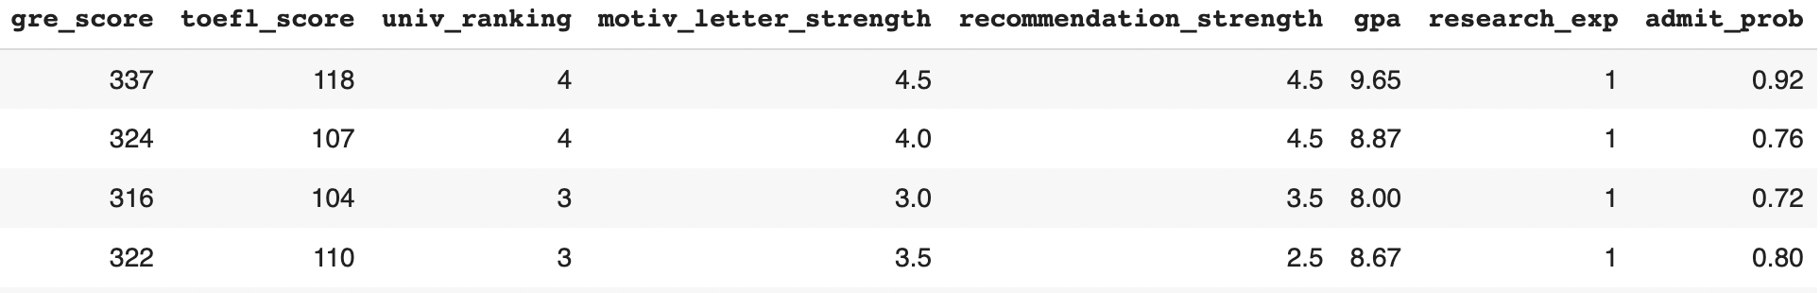
Machine Learning Logic
Logic
Use past data to make our model learns the feature-target relationship
Use the learned model to predict the target variable for new data points
features
target
Past Data
and many more rows…
New Data
?

Slide 8
ML Example (Regression)
RECAP
Consider a model to predict sales omzet (GMV) using different advertising channels
Features/Predictors
GMV = 0.7 + 2.1 socmed + 3.3 onmedia + 1.4 DOOH
Parameters/Coefficients
Target
The above is an example of a regression model:
Predict GMV (Sales omzet)
Predictors are different advertising channels

Slide 9


Slide 10
Contoh Case
Anda seorang data scientist, menerima sebuah tugas dari stakeholders
tolong prediksi pendapatan penjualan dengan biaya iklan yang dibayarkan di tiktok,
Hasil prediksi tersebut diharapkan dapat membantu stakeholders dalam dalam memproyeksikan biaya ikan di bulan depan .
Bagaimana kira-kira caranya?

Slide 11
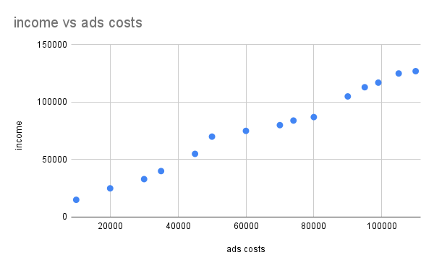
trend income vs ads costs
raw data
ads costs | income
10000 | 15000
20000 | 25000
30000 | 33000
35000 | 40000
45000 | 55000
50000 | 70000
60000 | 75000
70000 | 80000
74000 | 84000
80000 | 87000
90000 | 105000
95000 | 113000
99000 | 117000
105000 | 125000
118000 | 130000
prediksi income vs ads costs

Slide 12

Linear Regression
Formula
Linear regression is the oldest statistical model, invented by Legendre in 1805
On a high-level, linear regression is all about finding a straight line (linear) that fits the data most nicely
The mathematical form
y is target, x₁, x₂, .. x_{n} are predictors/features (set by modeler), b₀, b₁, b₂, …, b_{n} are parameters/coefficients (to learn from data)
Characteristics
Supervised learning (y is provided)
Regression model (y is quantitative/numeric)

Slide 13
Contoh
X (feature) |  |  | Linear Regression b0=1, b1=1, b2=2, b3=3 | Y (target)
fb | ig | tiktok | y = b0 + (fb*b1) + (ig*b2) + (titok*b3) | omzet
100k | 50k | 150k | 1 + (150k*1) + (50k*2) + (150k*3) | 700.001
70k | 60k | 200k | 1 + (70k*1) + (60k*2) + (200k*3) | 790.001
200k | 40k | 100k | 1 + (200k*1) + (40k*2) + (100k*3) | 580.001
115k | 100k | 50k | 1 + (115k*1) + (100k*2) + (50k*3) | 465.001
20k | 20k | 250k | 1 + (20k*1) + (20k*2) + (250k*3) | 810.001
Total cost
300k
330k
340k
265k
290k

Slide 14
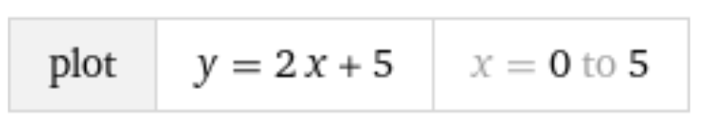
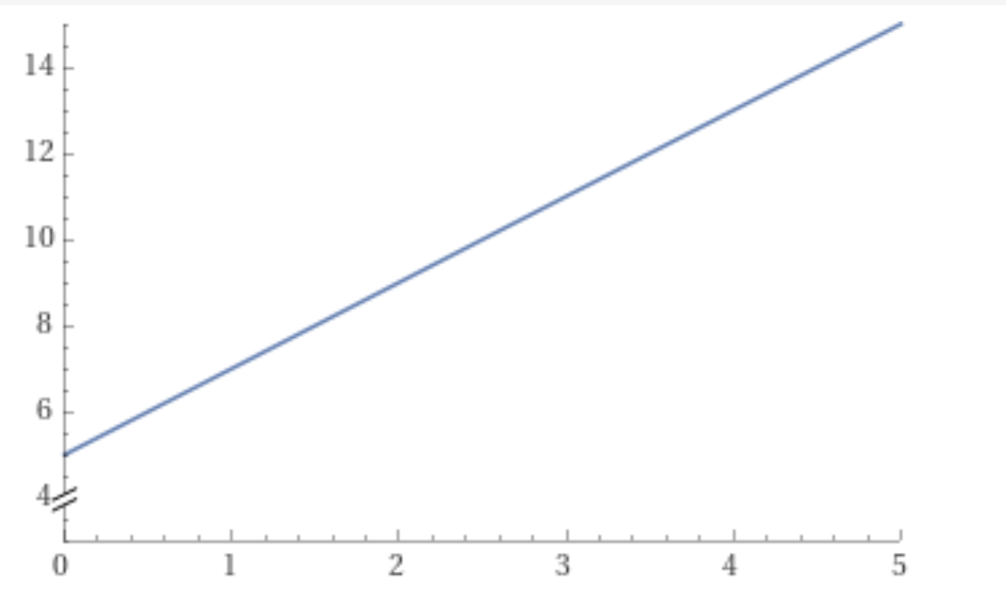
Linear equation
x = 1 → y = 2+5 = 7
x = 2 → y = 4+5 = 9
x = 2.11 → y = 2 (2.11) + 5 = 9.22
etc…

Slide 15


Simple Linear Regression
Y
Observed Value of Y for X_{i}
Slope = β₁
Predicted Value of Y for X_{i}
Residual/error untuk nilai X_{i}
Intercept = β₀
X
X_{i}

Slide 16
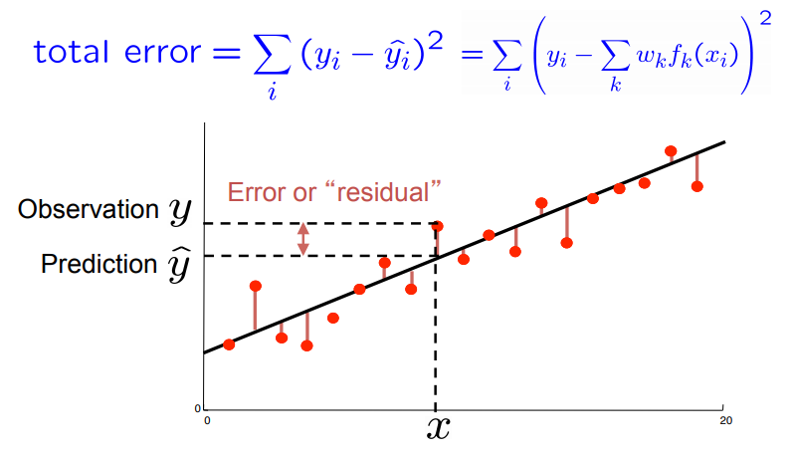
Residual
Residual (prediction error): delta between the real value of target variable y and the predicted value target variable y_{hat}
Real value - Predicted value
Predicted values = all points on the regression line
red points are our data points
black line is the regression line (our prediction values)

Slide 17
Residuals construct Loss Function
The magnitude we want to minimize when training the model
Residual: delta between the real target variable y and the predicted target variable y_{hat}
Predicted values = regression line
Train the model to minimize loss function: Residual sum of squares
Note: training == finding coefficients
red points are our data points
black line is the regression line (our prediction values)

Slide 19

Assumptions of Linear Regression

Slide 20
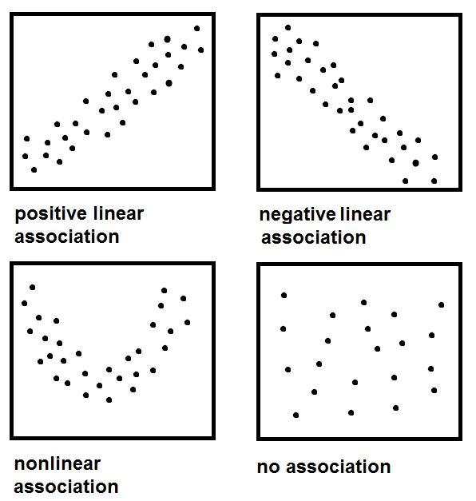
Assumption 1
There is a straight-line relationship between the predictors and the target
How do we check this?
One predictor: Scatter plot (like above)
Multiple predictors: Residual plot

Slide 21
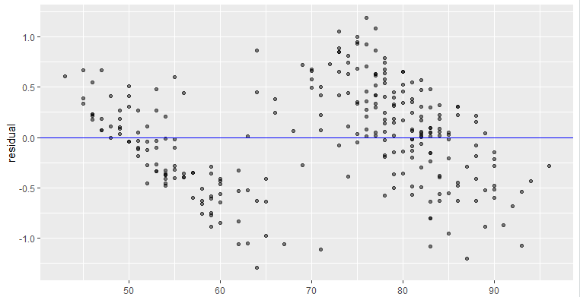
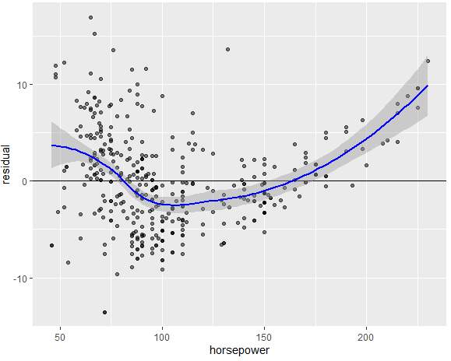
Assumption 1 (cont’d)
Checking linearity assumption via residual plot:
Validated if there is NO discerning non-linear pattern in residual plot

Slide 22
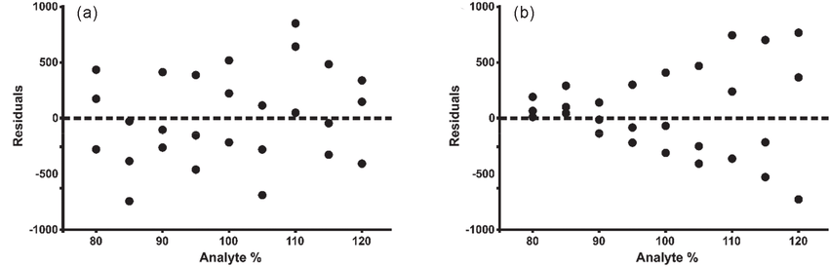
Assumption 2
Homoskedastisitas : residuals have a constant variance
Heteroskedastisitas : Residual variance is not constant

Slide 23
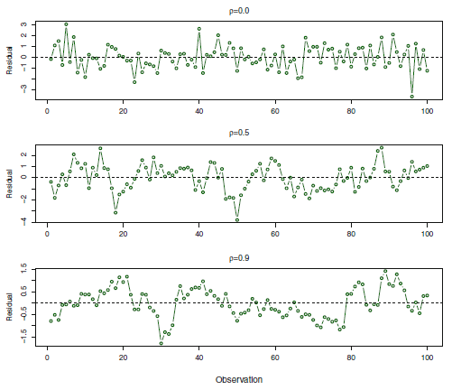
Assumption 3
Uncorrelated residuals between different observations
This is equivalent with independent observations
Satisfied if neighboring residuals look random

Slide 24
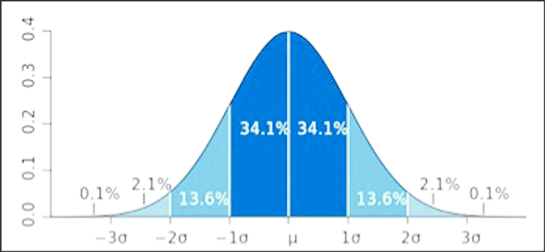
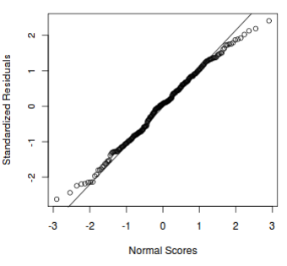
Assumption 4
Residuals are normally distributed
Can check using QQ-plot (Quantile-Quantile plot)

Slide 25
Remark on Assumptions
On real dataset, it is QUITE RARE all of those 4 assumptions are met
It is the reason why linear regression is usually underperformed on real world data
Nevertheless, just carry on! Real benefits of linear regression:
As a baseline model
Highly interpretable model
brp yang terpenuhi? lihat persentase error? acceptable?

Slide 27
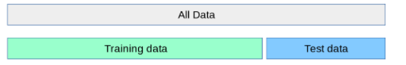

Essential rule in ML modelling
We are NOT allowed to use ALL of our data to train our model
Instead, we need to dedicate some portion of our data to become test data

Slide 28
Essential rule in ML modelling
We are NOT allowed to use ALL of our data to train our model
Instead, we need to dedicate some portion of our data to become test data
Because we want our ML model to generalize well on new data
I.e. perform well on unseen data
Test data is meant to mimic the unseen data

Slide 29
Linear Regression with Python
High level steps:
Split data: training-testing
Prepare as numpy arrays (X_train, y_train; X_test, y_test)
Define and train the model on the training data:
Define model: linreg = LinearRegression()
Train model: linreg.fit(X_train, y_train)
Interpret and pre-evaluate the model (model diagnostic)
Using the trained model to predict test data
linreg.predict(X_test)
Evaluate the model
Using various regression metrics

Slide 30
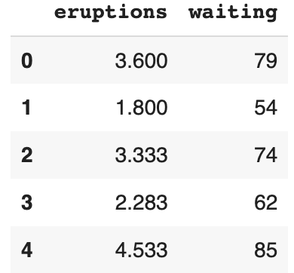
Example: Simple Linear Regression
Regression with only 1 predictor
We will use faithful.csv data
eruptions: Eruption time (in mins)
waiting: Waiting time to next eruption (in mins)
We regress eruptions using waiting
faithful.head()

Slide 31
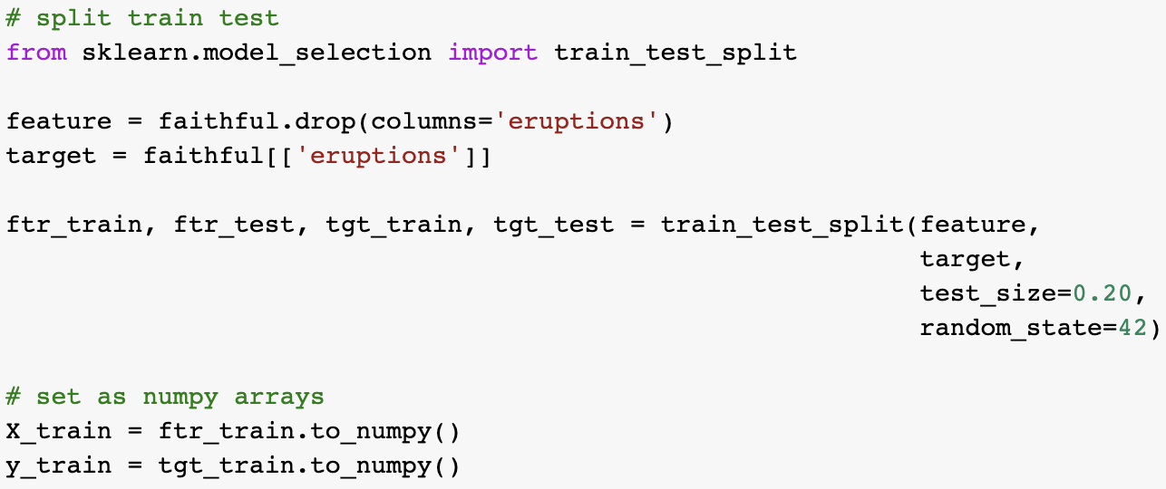
Example: Simple Linear Regression
Splitting data
We use 80:20 split
For reproducibility

Slide 32
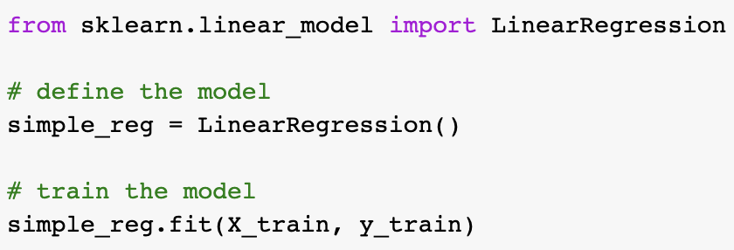
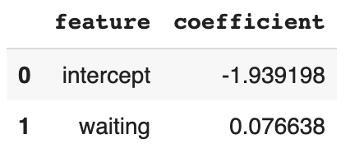
Example: Simple Linear Regression
Model Training and Obtained Coefficients
eruptions = -1.939 + 0.076 waiting
-1.939: when waiting is 0, the expected value of eruptions is -1.939
0.076: an increase of 1 on waiting time is associated with an increase of 0.076 on eruptions

Slide 33
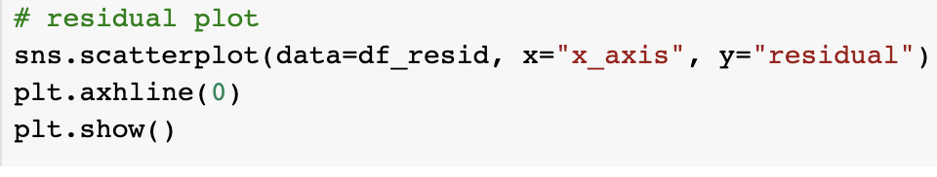
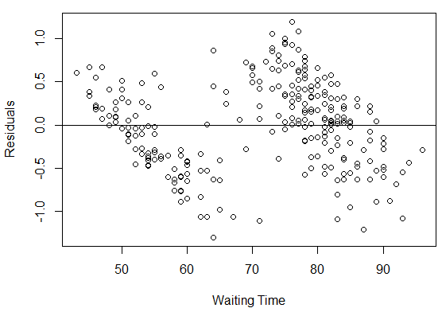
Residual Plot
To check three assumptions of linear regression
For model with 1 predictor (feature):
x-axis = feature value
y-axis = residual value
Assumptions to check via residual plot:
Linear relationship ✔️
Constant variance ❌ (look at red curves)
Independent observations ❌ (look at blue lines)

Slide 34
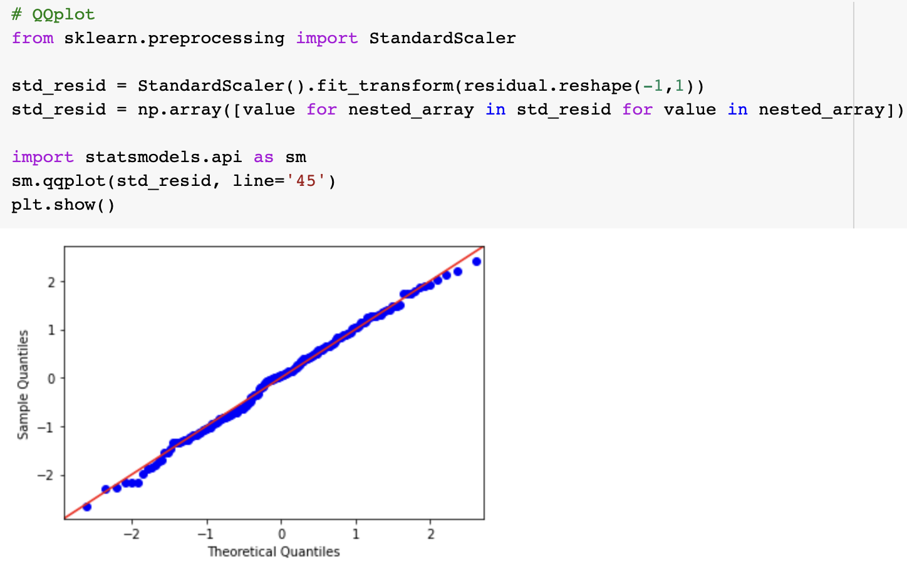
QQ-Plot
To check normality assumption of the residuals
QQ plot for residual
To check normality assumption ✔️

Slide 36


Hands-On
Open today’s Jupyter notebook on your Google Colab!
Make sure you have uploaded the required CSV files to your google drive
Remember the file path!

Slide 37
Multiple Linear Regression
The Data Used
For the rest of the lecture, we will use regression_data.csv
The data is about university admit probability, based on several applicant’s features
GRE score
TOEFL score
University ranking
Motivation letter quality
Recommendation letter strength
GPA
Research experience

Slide 38
1
Split the data
80 : 20 is fine
2
Multicollinearity check
Calculate VIF score for each feature
Correlation analysis to drop redundant feature
Modeling Flow
for >1 predictor
Fit the model on training data
3
Define and fit LinearRegression()
Only include retained features from step 2
4
Model diagnostic
Residual plot
QQ plot
R2 score on training data
5
Evaluate the model on test data
RMSE

Slide 39
mhs | is female | is male
lintang | 1 | 0
arif | 0 | 1
mhs | is female
lintang | 1
arif | 0

Slide 40
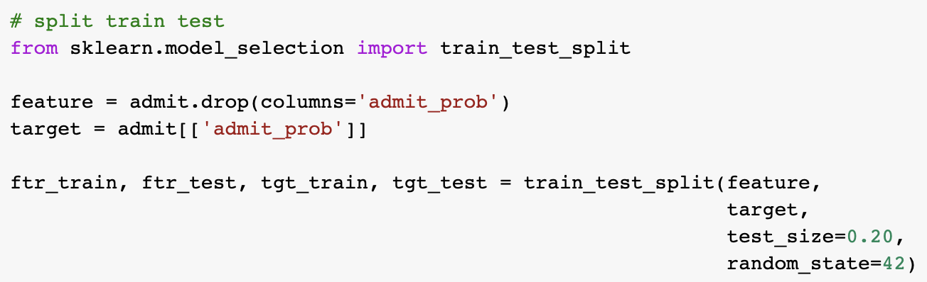
Split the Data
Using train_test_split() function
Recall, we want to predict admit_prob

Slide 41
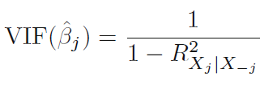
Multicollinearity (1/2)
Variance Inflation Factor
Multicollinearity: when two or more features/predictors are highly correlated with each other
This can cause coefficients of estimates become unreliable
i.e. little change in the training data leads to completely different learned coefficients
We can detect this by computing Variance Inflation Factor (VIF) for each feature
On a high level: VIF feature j will be high if j can be predicted using the rest of other features. Vice versa
VIF == 1 → No multicollinearity
VIF between 4 and 10 → Moderate multicollinearity
VIF > 10 → Severe multicollinearity

Slide 42
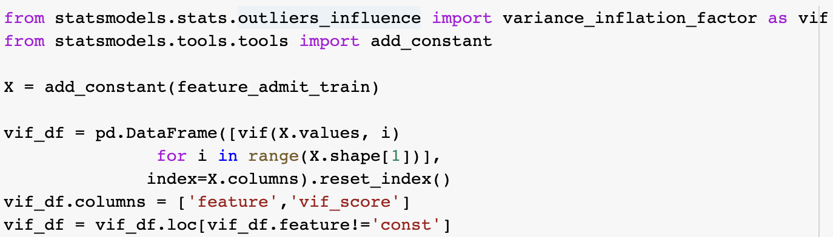
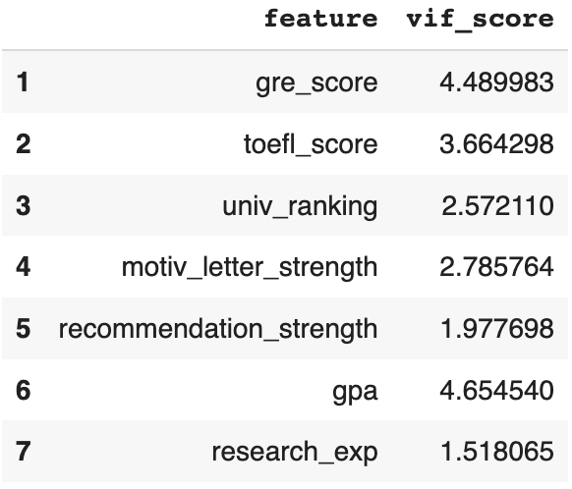
Multicollinearity (2/2)
Using statsmodels library

Slide 43
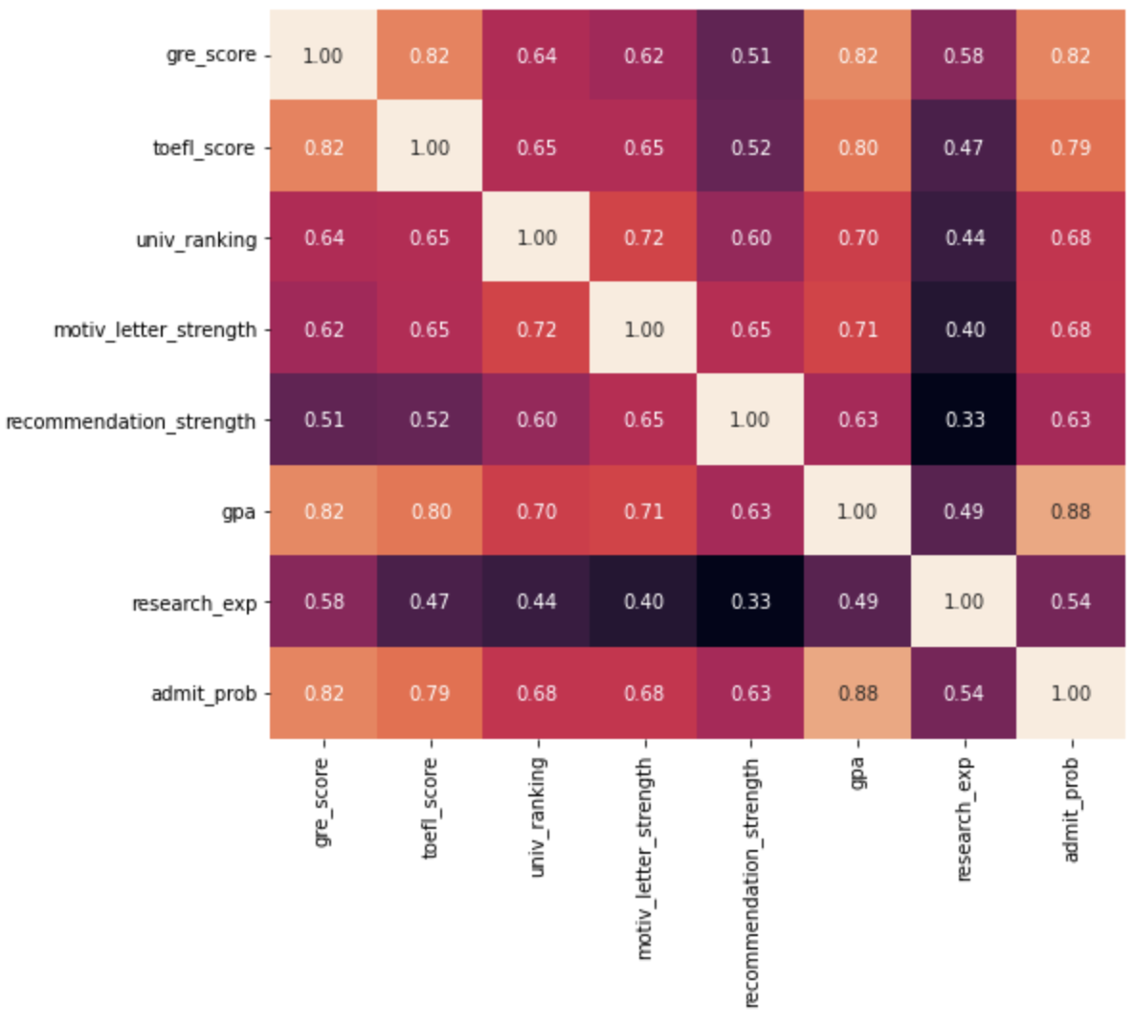
Feature Correlation
To prevent multicollinearity
We can draw a correlation heatmap
Using sns.heatmap()
We found that gre_score, toefl_score, and gpa are highly correlated each other
We decide to include only gpa to represent these three features
Because it is the most correlated with the target variable
Note: Threshold: abs(corr) >= 0.8

Slide 44
Feature Correlation
To prevent multicollinearity
We can draw a correlation heatmap
Using sns.heatmap()
We found that gre_score, toefl_score, and gpa are highly correlated each other
We decide to include only gpa to represent these three features
Because it is the most correlated with the target variable
Note: Threshold: abs(corr) >= 0.8

Slide 45
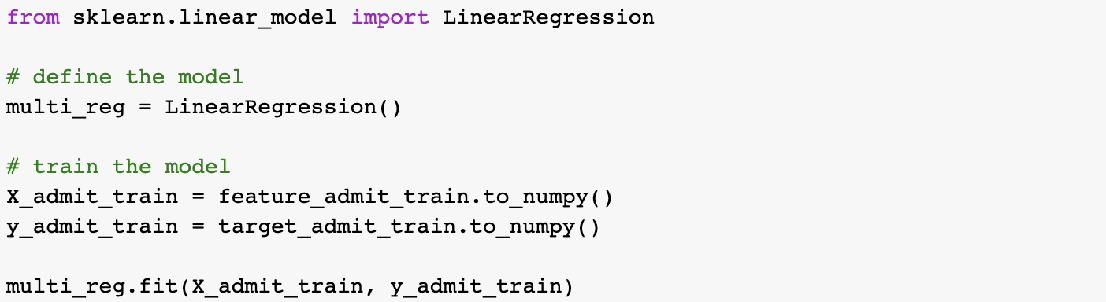
Training the Model
Excluding gre_score and toefl_score

Slide 46
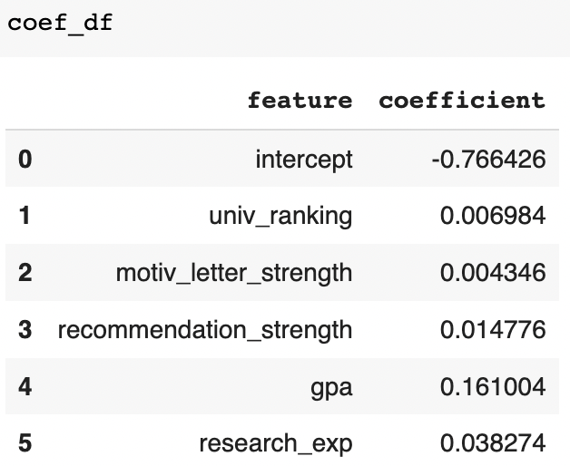
Interpreting the Obtained Model
admit_prob = -0.766
+ 0.007 univ_ranking iiiiiiiiiiiii
+ 0.004 motiv_letter
iiiiiiiiiiiii + 0.015 recom
+ 0.161 gpa
iiiiiiiiiiiii + 0.038 research
Sample coeff interpretation:
An increase of 1 point in GPA, while the other features are kept fixed, is associated with an increase of 0.161 point in admit_prob

Slide 47
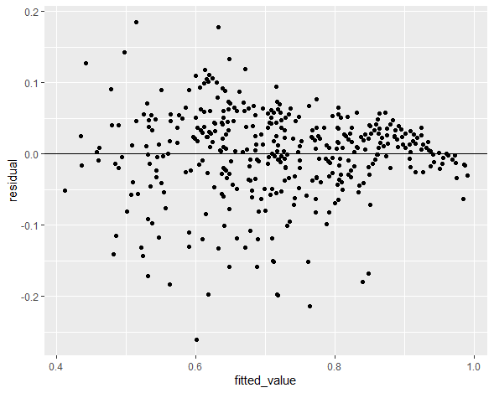
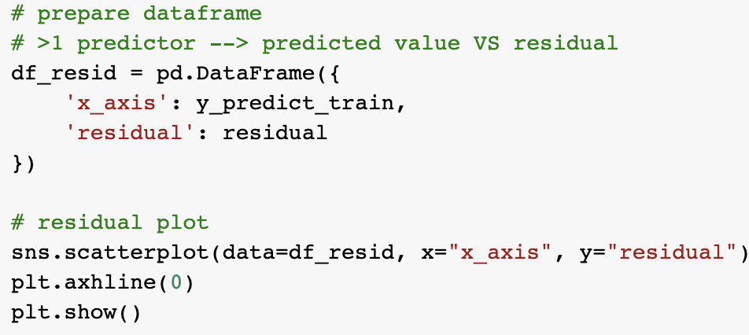
Residual Plot
To check three assumptions of linear regression
For >1 predictor: residual vs predicted_target
Linear relationship ✔️
Constant variance ❌
Independent observations ✔️

Slide 48
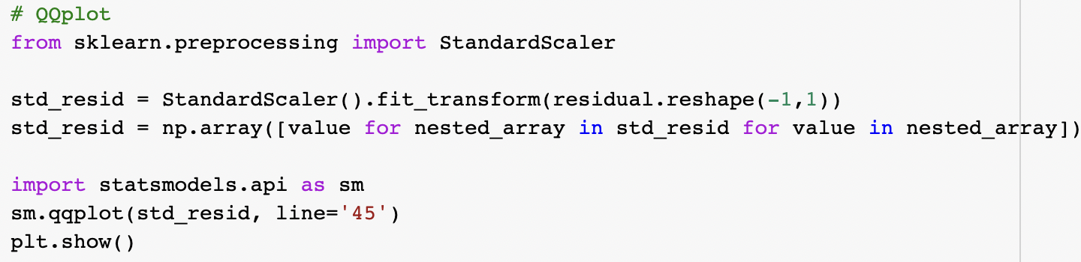
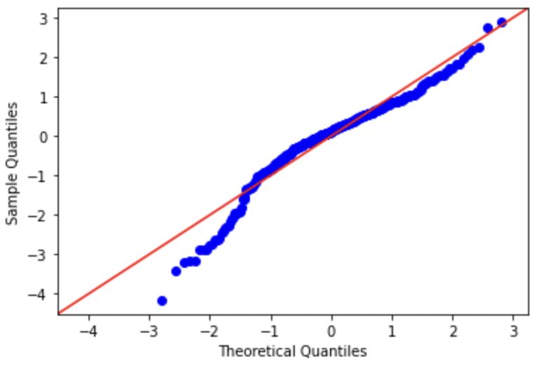
QQ-Plot
The same as before
Normality ✔️
Slightly skewed, though

Slide 49
Hands-On
Open today’s Jupyter notebook on your Google Colab!
Make sure you have uploaded the required CSV files to your google drive
Remember the file path!

Slide 50
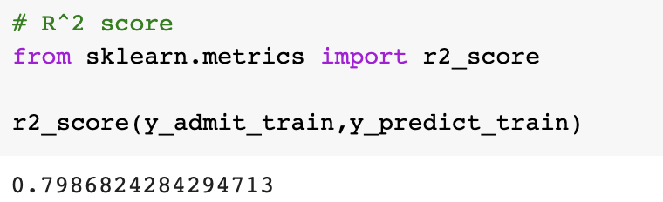
R2 Score
R2 score measures portion of variability of the target variable that is successfully explained (modelled) by the features included in the model
The higher == the better
Max value (not possible, though) is 100%
Interpretation: 79.86% of variability of admit_prob is successfully explained using all the features in the model

Slide 51
R2 Score
R2 score measures portion of variability of the target variable that is successfully explained (modelled) by the features included in the model

Slide 52
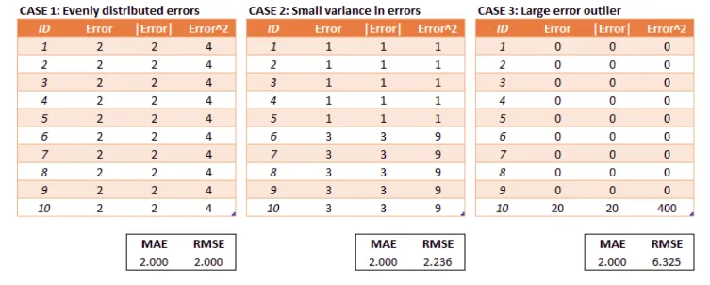
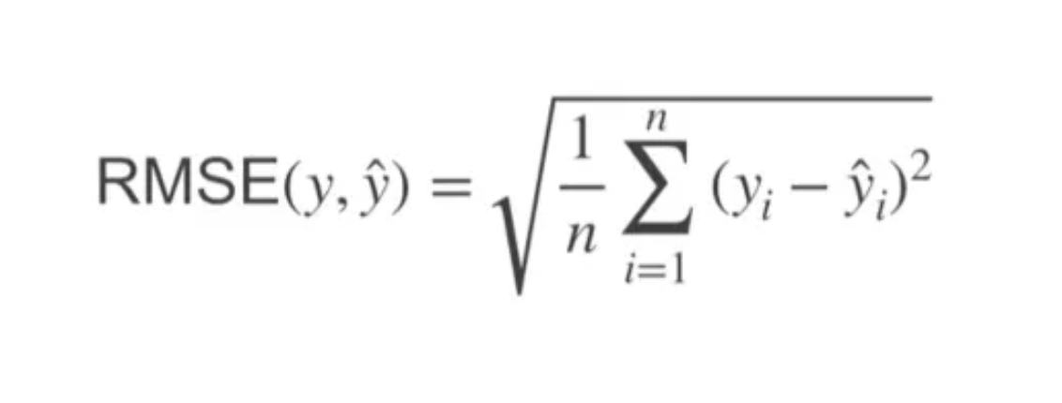
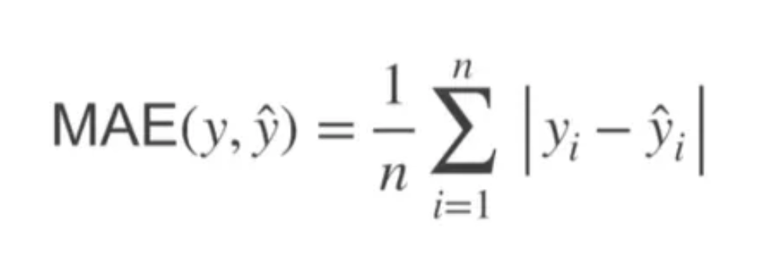
RMSE and MAE (1)
RSME dan MAE : dua metrik yang umum digunakan untuk mengukur tingkat kesalahan (error) suatu model prediksi.
Interpretasi: MAE memberikan nilai rata-rata kesalahan dalam satuan yang sama dengan data asli. Semakin kecil nilai MAE, semakin akurat model prediksi.
RMSE memberikan nilai rata-rata kesalahan dalam satuan yang sama dengan data asli. Namun, karena kesalahan dikuadratkan terlebih dahulu, kesalahan yang besar akan memberikan kontribusi yang lebih besar pada nilai RMSE.

Slide 53
RMSE and MAE (1)
Simulasi
Kasus : memprediksi penjualan produk di toko konoha
Distribusi : rata-rata 1 produk terjual 1000 dalam 1 bulan
MAE : 10 : ketika memprediksi ada error +- sekitar 10 dari rata-rata 1000. 10/1000 = 1%
RMSE : 30
Bagaimana menjelaskan performa model berdasarkan error kepada stakeholders?
harga motor -> mae : 1 juta
harga motor : 20jt : 1jt
harga mobil -> mae : 2 juta
harga mobil 250 jt : 2 jt
mae jelek
r2 bagus

Slide 54
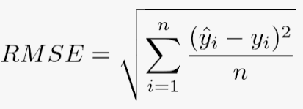
Model Evaluation (1/2)
After we are satisfied (enough) with the model, we perform model evaluation
Essentially, we check how is the model performance on test data
To do so, we will compute evaluation metric
Root Mean Squared Error (RMSE):
The standard deviation of our prediction errors with respect to the regression line
It is a measure of how spread out the residuals are

Slide 55
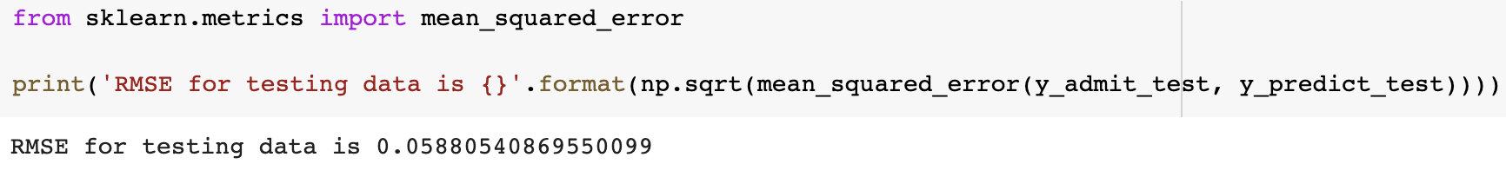
Model Evaluation (2/2)
RMSE = 0.058
The standard deviation of prediction errors is 0.058
i.e. from the regression line, the residuals mostly deviate between +- 0.058

Slide 57
Thank you

